Slide 1
Ross Stores & DD’s Discounts
Accessing Supplier Portal
Aug2023

Slide 2

Supplier Portal: Whats New…
  New URL & login credentials
  No 6 month certificate renewal required
  Easier onboarding process
  New Look & Feel
  Single sign on for
    Invoices
    Payments
    Account Balance
2

Slide 3
Supplier Portal – Login
URL: https://vendors.rossstores.com
0.1 First Time Login
0.2 Daily Login
0.3 Forgot Password
3

Slide 4
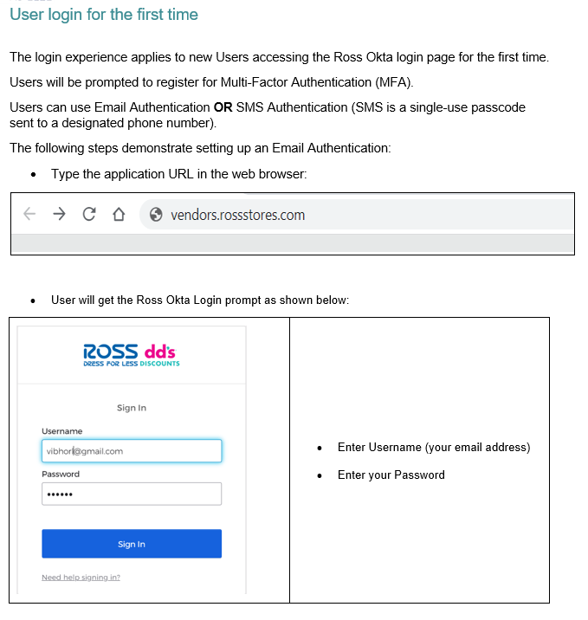
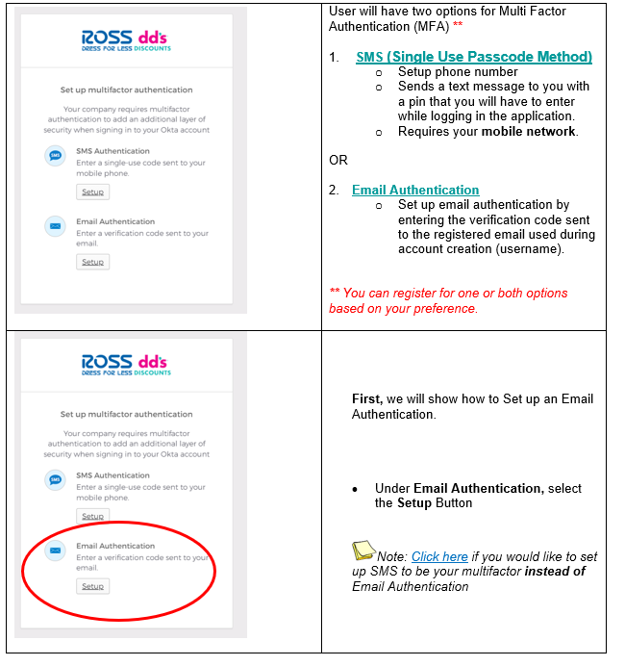
0.1 Supplier Portal – First time Login
d
f
g
a
b
4

Slide 5
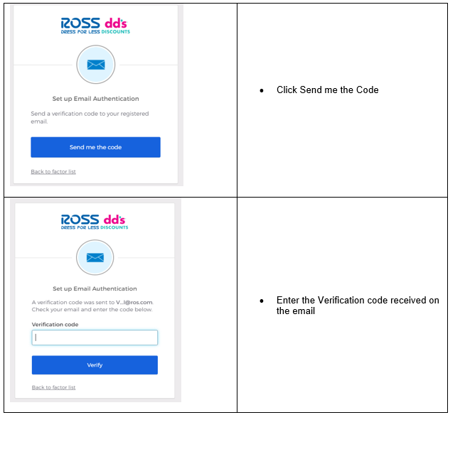
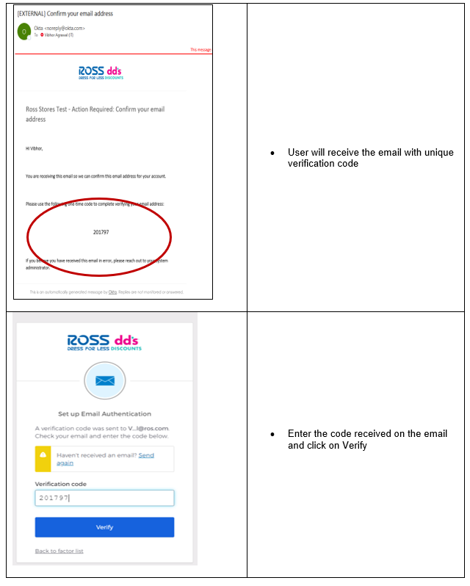
0.1 Supplier Portal – First time Login
d
f
g
a
b
5

Slide 6
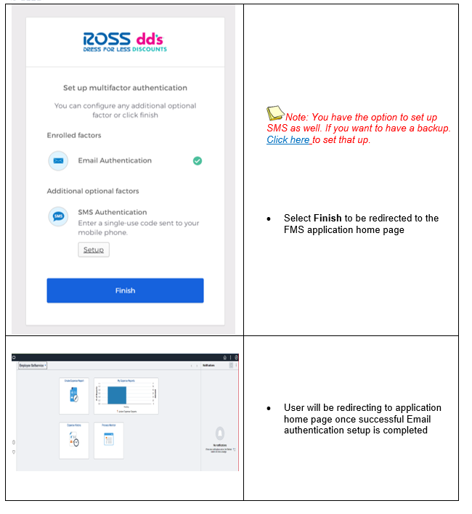
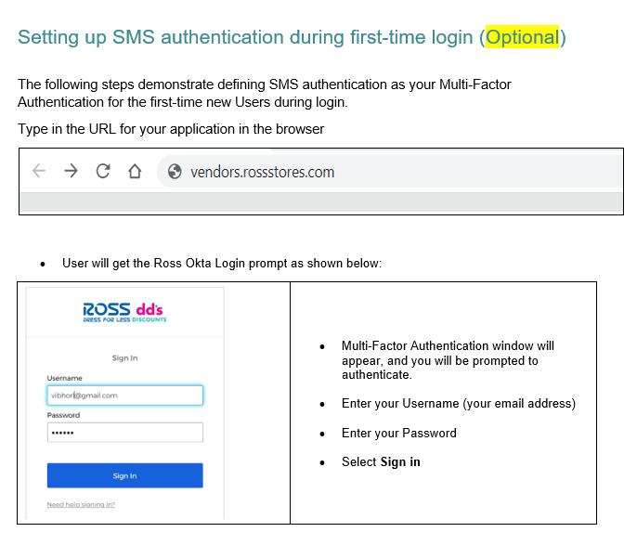
0.1 Supplier Portal – First time Login
6

Slide 7
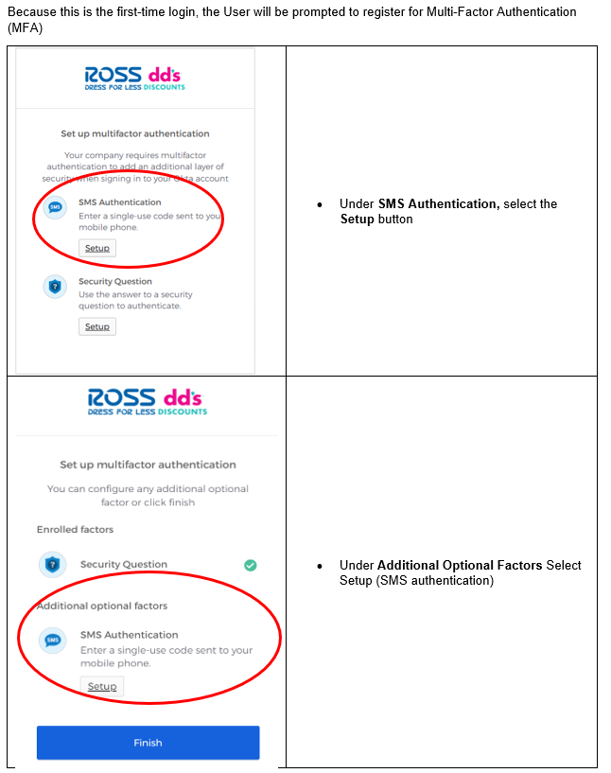
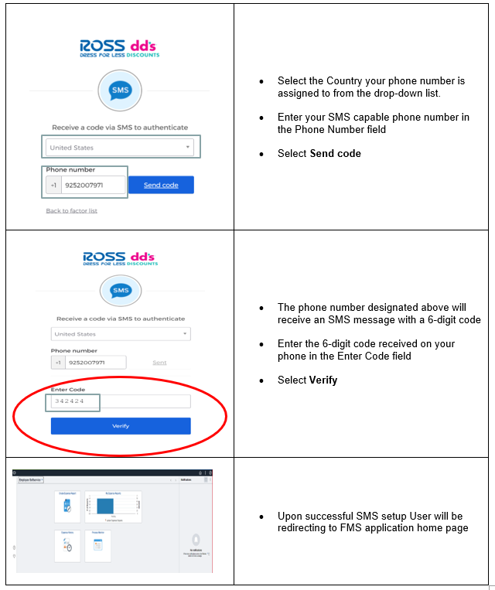
0.1 Supplier Portal – First time Login
7

Slide 8
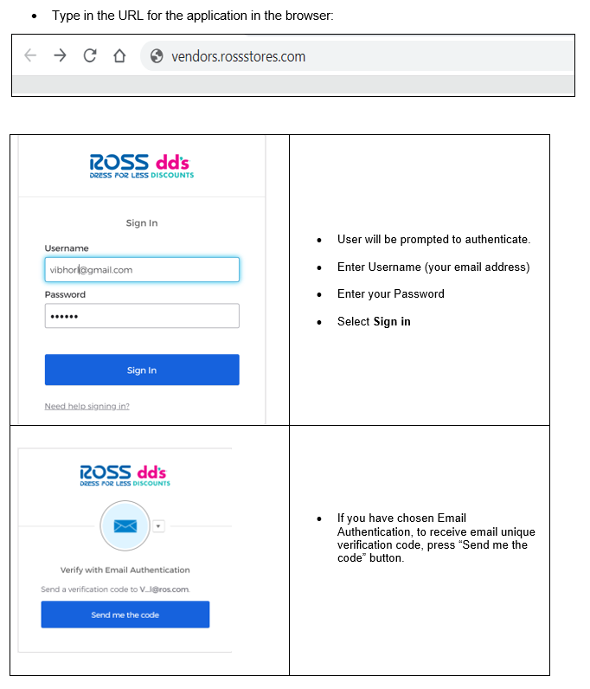
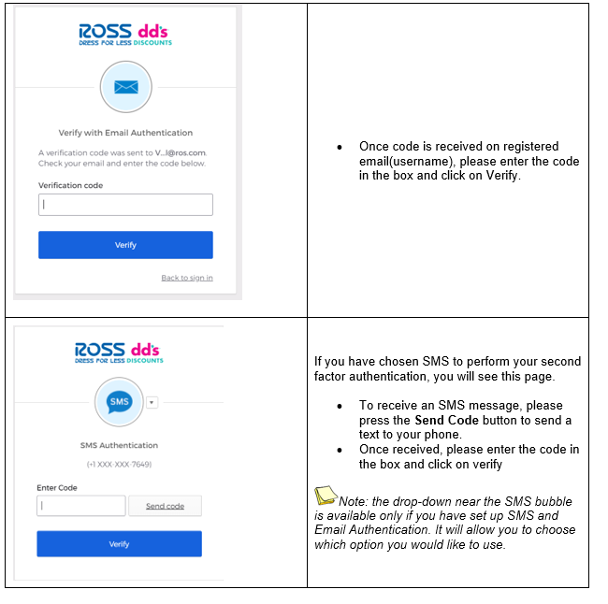
0.2 Supplier Portal – Daily Login
8

Slide 9
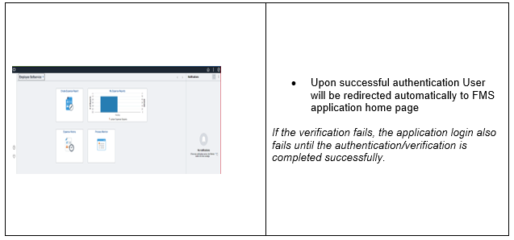
0.2 Supplier Portal – Daily Login
9

Slide 10
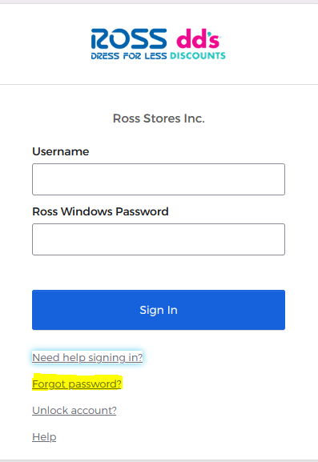
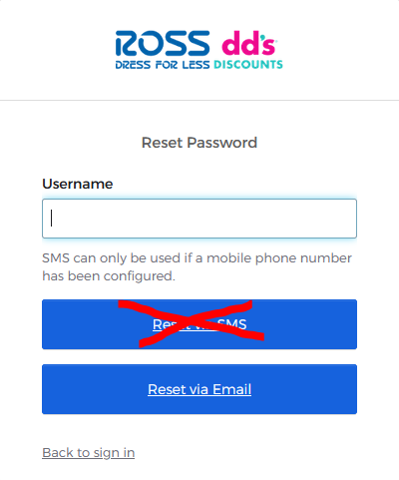
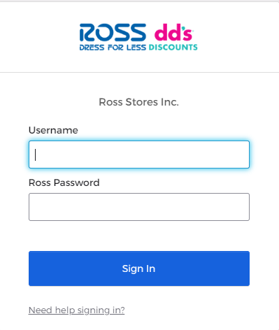
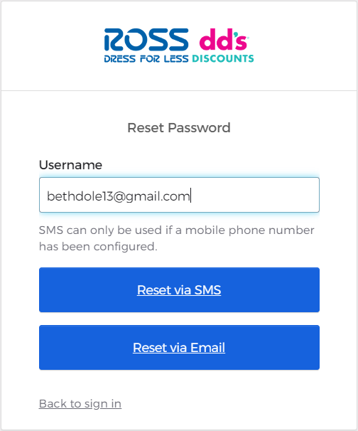
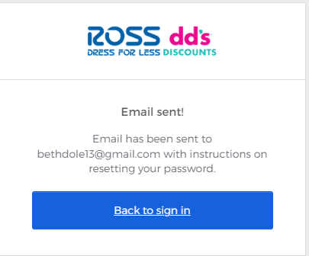
0.3 Supplier Portal –Forgot Password
Log Into Portal, click on Need Help Signing In?
  Click Forgot Password
  Enter your username
  Request via Email (Note: You can’t reset using SMS)
10

Slide 11
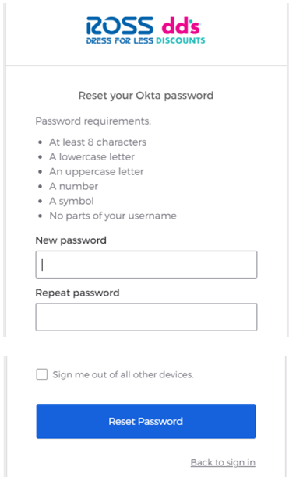
0.3 Supplier Portal –Forgot Password
Check your email and click on the Reset Email link and you will have the option to reset your password
11

Slide 12
Supplier Portal – Single Location
1.1 Supplier Portal – Account Balances
1.2 Supplier Portal – Invoices
1.3 Supplier Portal – Payments
12

Slide 13

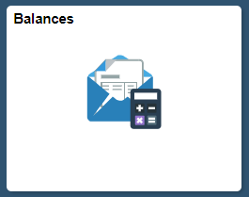


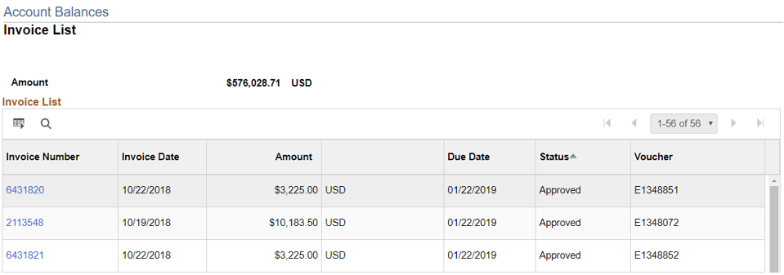
1.1 Supplier Portal – Account Balances
To get back to the tile screen press the home button on the top right of the page
Select the Balances Tile
Account Balances displayed in Invoice list
Click on the Invoice Numbers ID hyperlink to review details of the pending invoice.
1
2
3
4
13

Slide 14

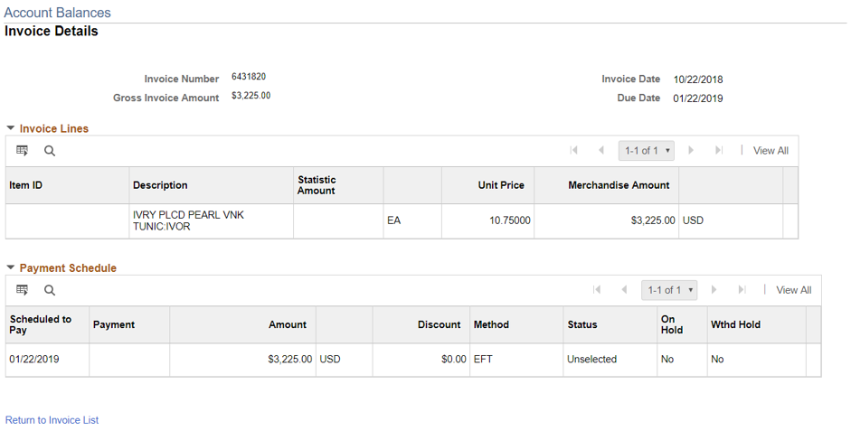
1.1 Supplier Portal – Account Balances
Invoice lines and Payment schedule for the invoice is displayed.
Click on ‘Return to Invoice List’ to navigate back to pending invoice page.
5
6
14

Slide 15
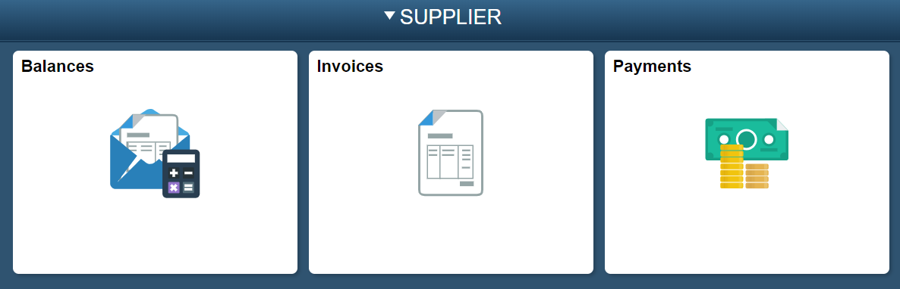
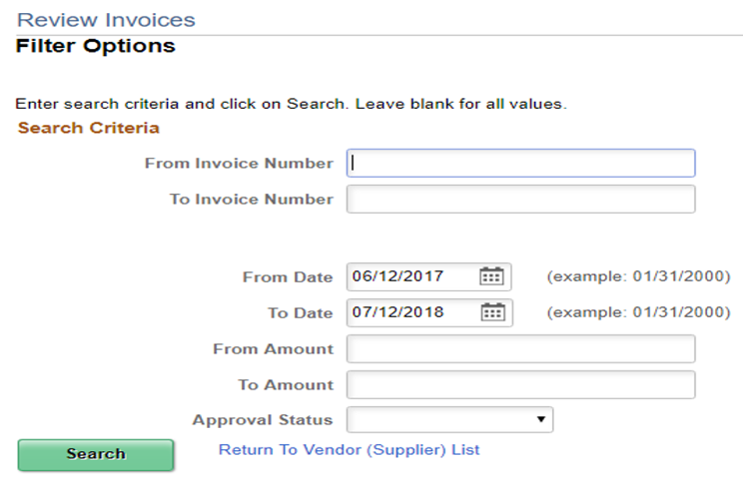
1.2 Supplier Portal – Invoices
1
Select the Invoices tile
Enter range of invoice number(s), date range, or Invoice amount
Click search button
2
3
15

Slide 16
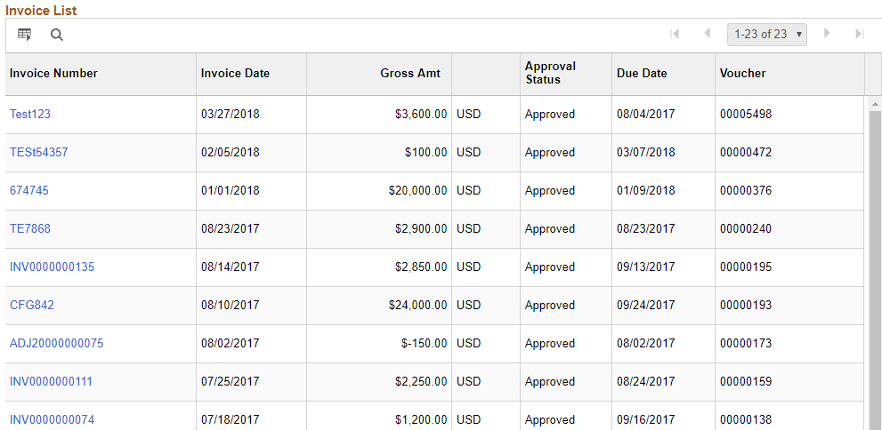
1.2 Supplier Portal – Invoices
Invoices List is displayed based on the search parameters previously provided.
Click on the Invoice Number hyperlink to review details of the Invoice.
4
16

Slide 17
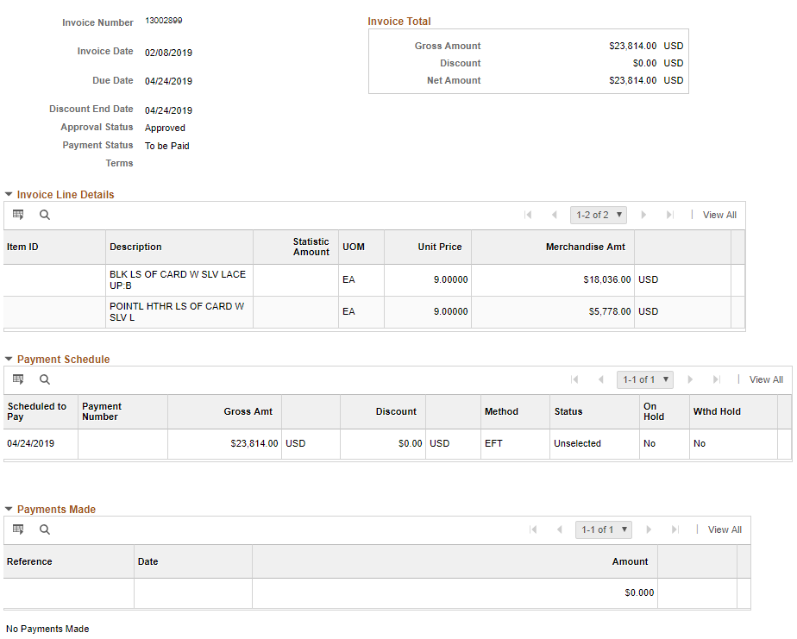
1.2 Supplier Portal – Invoices
Invoice details are displayed
  Invoice Total
  Invoice Line Detail
  Payment Schedule
  Payments Made
a
b
c
d
17

Slide 18
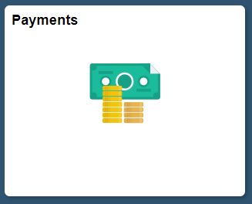
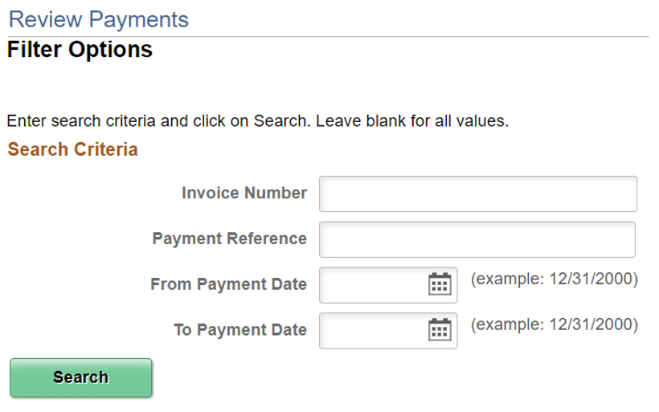
1.3 Supplier Portal – Payments
To get back to the tile screen press the home button on the top right of the page
Select the Payments Tile
Enter Invoice information then select search
1
2
3
18

Slide 19
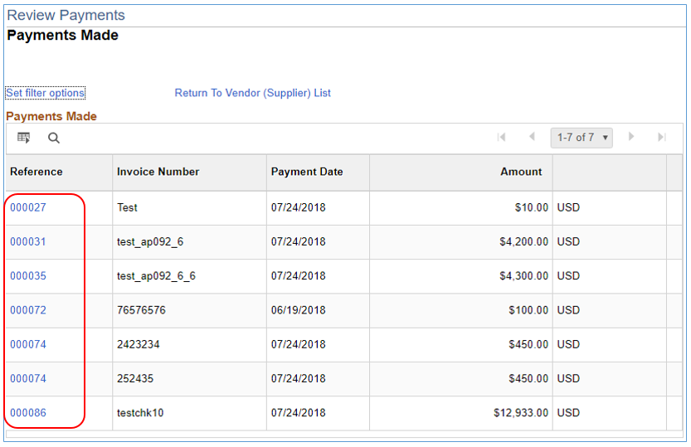

1.3 Supplier Portal – Payments
Payments Made List is displayed based on the search parameters provided.
Click on the Payment Reference ID hyperlink to review details of the payments.
4
19

Slide 20
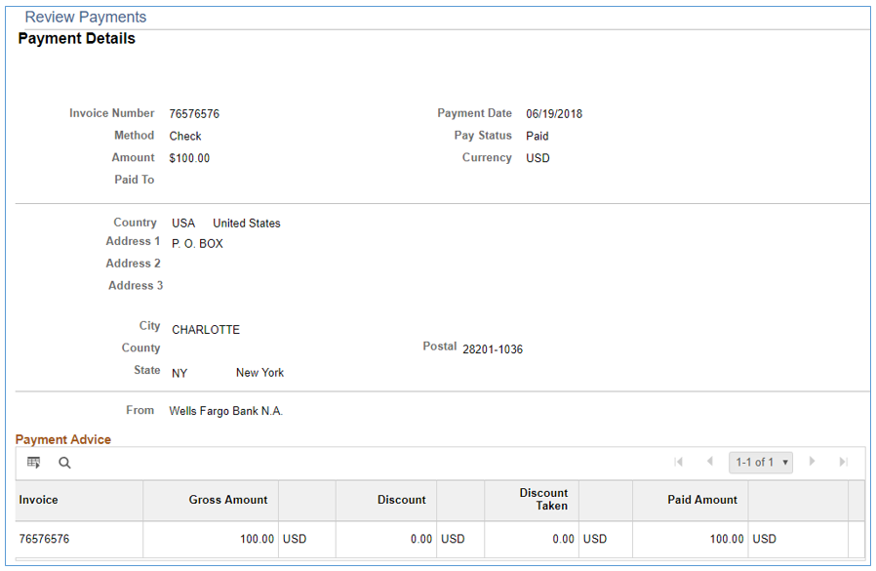

1.3 Supplier Portal – Payments
Payment details are displayed.
20

Slide 21
Supplier Portal – Multiple Vendor IDs
This is for vendors and factors that have multiple vendor accounts that have been assigned to their username
2.1 Supplier Portal – Account Balances
2.2 Supplier Portal – Invoices
2.3 Supplier Portal – Payments
21

Slide 22
2.1 Supplier Portal – Account Balances
To get back to the tile screen press the home button on the top right of the page
Select the Balances Tile
Account Balances displayed in Invoice list
Click on the Invoice Numbers ID hyperlink to review details of the pending invoice.
1
2
4
3
22

Slide 23
2.1 Supplier Portal – Account Balances
Invoice lines and Payment schedule for the invoice is displayed.
Click on ‘Return to Invoice List’ to navigate back to pending invoice page.
5
6
23

Slide 24
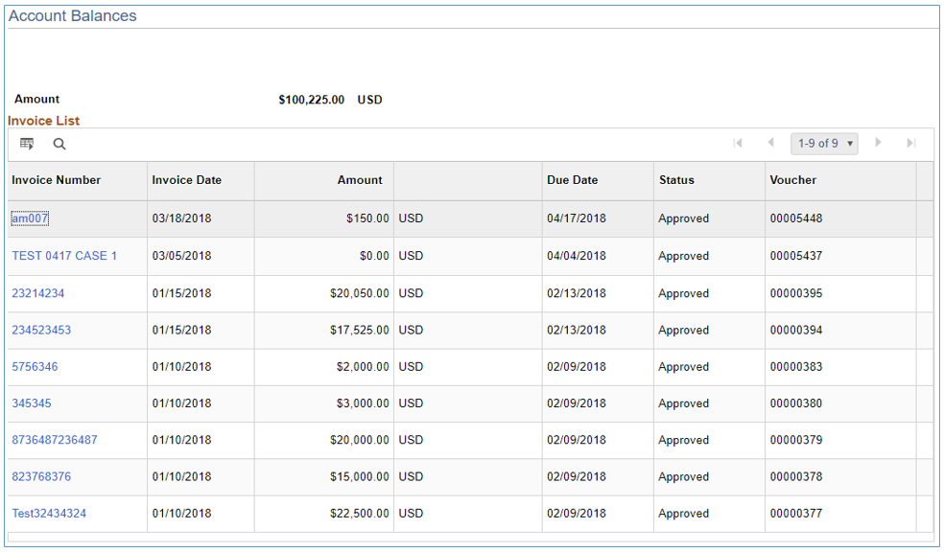

2.1 Supplier Portal – Account Balances
Invoice List is displayed for the selected Supplier.
24

Slide 25
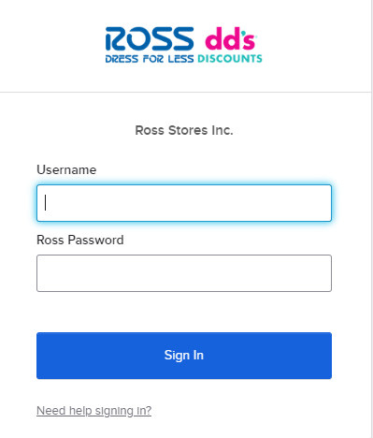
2.2 Supplier Portal – Invoices
Log in to Supplier Portal
Select Invoices Tile
1
2
25

Slide 26
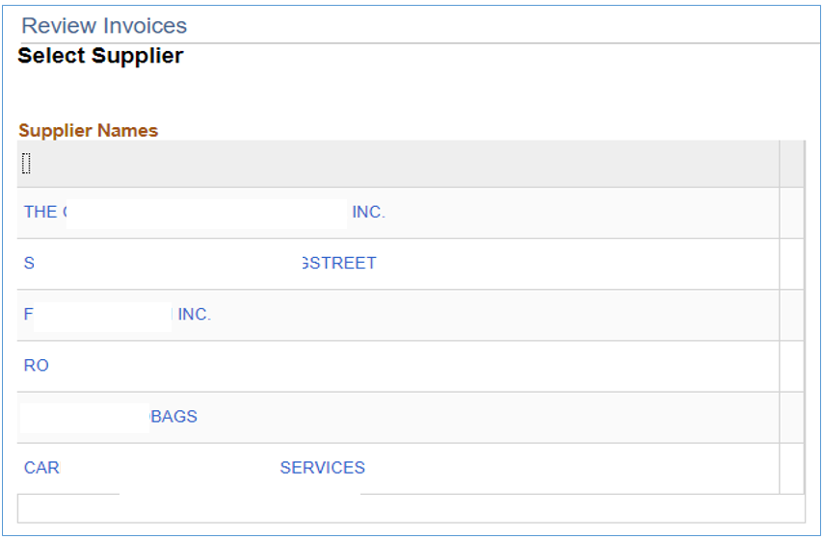
2.2 Supplier Portal – Invoices
The page opens with the list of Suppliers that are associated with the logged user. In this example, 6 different suppliers have been mapped to the supplier user.
Click on the required Supplier to retrieve the account balance information.
Enter range of invoice
  number(s)
  date range
  or Invoice amount
Click search button
3
5a
5b
5c
26

Slide 27
2.2 Supplier Portal – Invoices
Invoices List is displayed based on the search parameters previously provided.
Click on the Invoice Number hyperlink to review details of the Invoice.
8
27

Slide 28
1.2 Supplier Portal – Invoices
Invoice details are displayed
  Invoice Total
  Invoice Line Detail
  Payment Schedule
  Payments Made
a
b
c
d
28

Slide 29
2.3 Supplier Portal – Payments
To get back to the tile screen press the home button on the top right of the page
Select the Payments Tile
Enter Invoice information then select search
1
2
3
29

Slide 30
2.3 Supplier Portal – Payments
Payments Made List is displayed based on the search parameters provided.
Click on the Payment Reference ID hyperlink to review details of the payments.
4
30

Slide 31
2.3 Supplier Portal – Payments
Payment details are displayed.
31

